Slide 1

REPUBLIC OF CAMEROUN
REPUBLIQUE DU CAMEROUN
Peace – Work - Fatherland
Paix – Travail - Paitre
Buea, South West Region
Buea, Sud Quest Region
P.O. Box 63
P.O. Box 63
University of Buea
FACULTY OF ENGINEERING AND TECHNOLOGY
Department of Computer Engineering
CEF599 : Internship
SCHOOL MANAGEMENT SYSTEM : ACADEMIA V2
By
NGWASIRI RYAN TANIFORM ONGA
FE21A266
Academic Supervisor
Prof Elie Fute
Technical Supervisor
Mr. Nfor Nde

Slide 2
TABLE OF CONTENT
01
Introduction
05
02
Company Overview
06
Project UI/UX Designs
03
Project Review
07
Challenges and Solutions
04
Development Diagrams
08
Conclusion

Slide 3

Introduction
01

Slide 4
What is Internship?
Internship provides a bridge between practical learning and professional application.
This program allows personnel to apply theoretical knowledge in a professional setting, refine my expertise as a full-stack developer, and prepare for future challenges in the tech industry.

Slide 5

Company Overview
02

Slide 6







About Company
Here’s some info about Zinger Systems
Founders and CEOs
Mr. Valery Colong, Mr. Fua Tse
Web Development
Mobile App Development
Zinger Systems Limited is a full-fledged IT service provider with a focus on enterprise web and mobile solutions development.
DevOps
U/UX Design
Location
Beside 7 Days Adventist Hospital, Buea

Slide 7





Details of Internship
Here are the details of my internship program
Duration of Internship
Role Assigned
Full stack developer intern
7th June 2024 – 7th January 2024
6 months
Main Task
Supervisors
Full Stack Web Development
Mr. Nfor Nde
Prof. Elie Fute

Slide 8
Internship Activities
Here are activities in the internship
Meetings
Onsite meetings and Skype meetings held every week
Debugging and Testing
Coding sessions, reviews, debugging and testing
Reports
Reports given at the end of every week on standups
Design Discussions
Extra-curricular Activities
UI/UX design features were discussed for implementation
Activities like social gatherings, meetings, new-man tasks and Friday share

Slide 9

Project Review
03

Slide 10

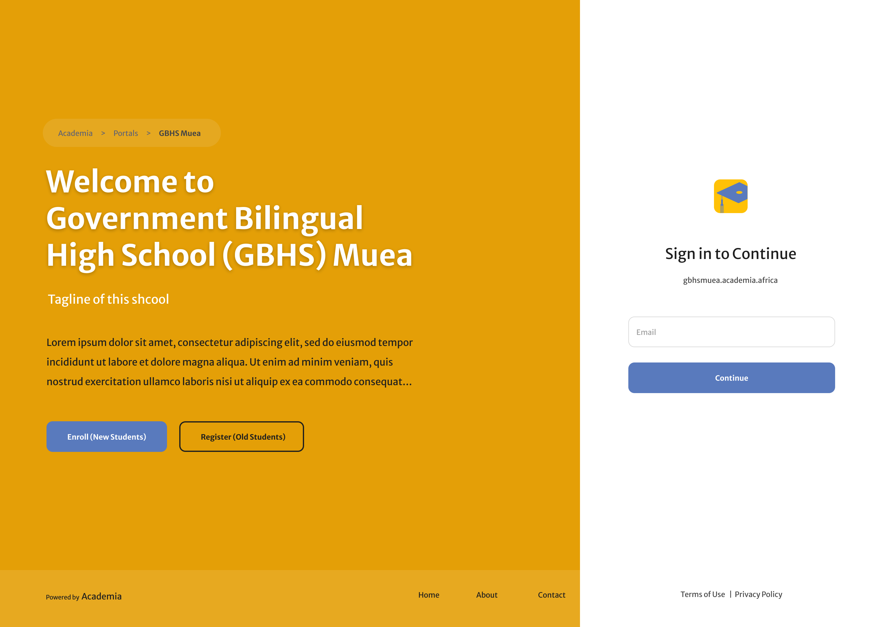

SCHOOL MANAGEMENT SYSTEM
Academia V2

Slide 11




What is Academia V2?
Academia is a school management system designed to make the digitization process of any school seamless, painless and without hassle. Academia is used across multiple secondary schools in Cameroon currently.
Eases school management
Eases task automations such as enrollment and admission
Provides Statistical Data
Provides statistical data such as reports and
feedbacks.
Task Automation
Eases task automations such as enrollment and admission

Slide 12




Academia V2 Functionalities
Administrative Control
User Management
User Authentication , User Management , Profile Management
Manage users roles.
Monitor and oversee academic and operational reports.
Create new programs, courses, and departments.
Attendance Tracking
View and report attendance records
Academic Structure Management
Institution Setup
Faculty Management
Department Management
Program Management
Course Management.
Reporting and Analytics
Generate reports on student performance, attendance, and enrollment.

Slide 13

















Academia V2 Tech Stack and Tools
Frontend
Backend
Tools

Slide 14

Development Diagrams
04

Slide 15
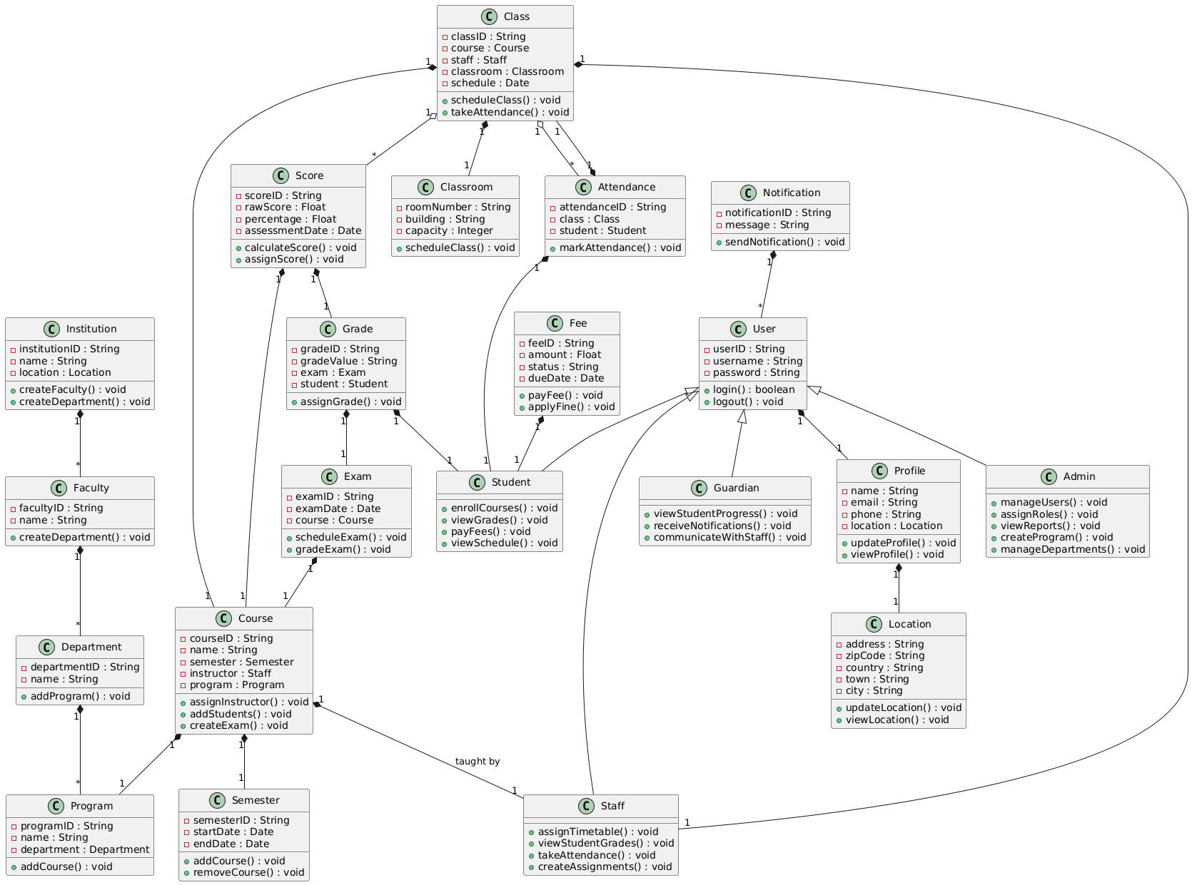
Class Diagram

Slide 16
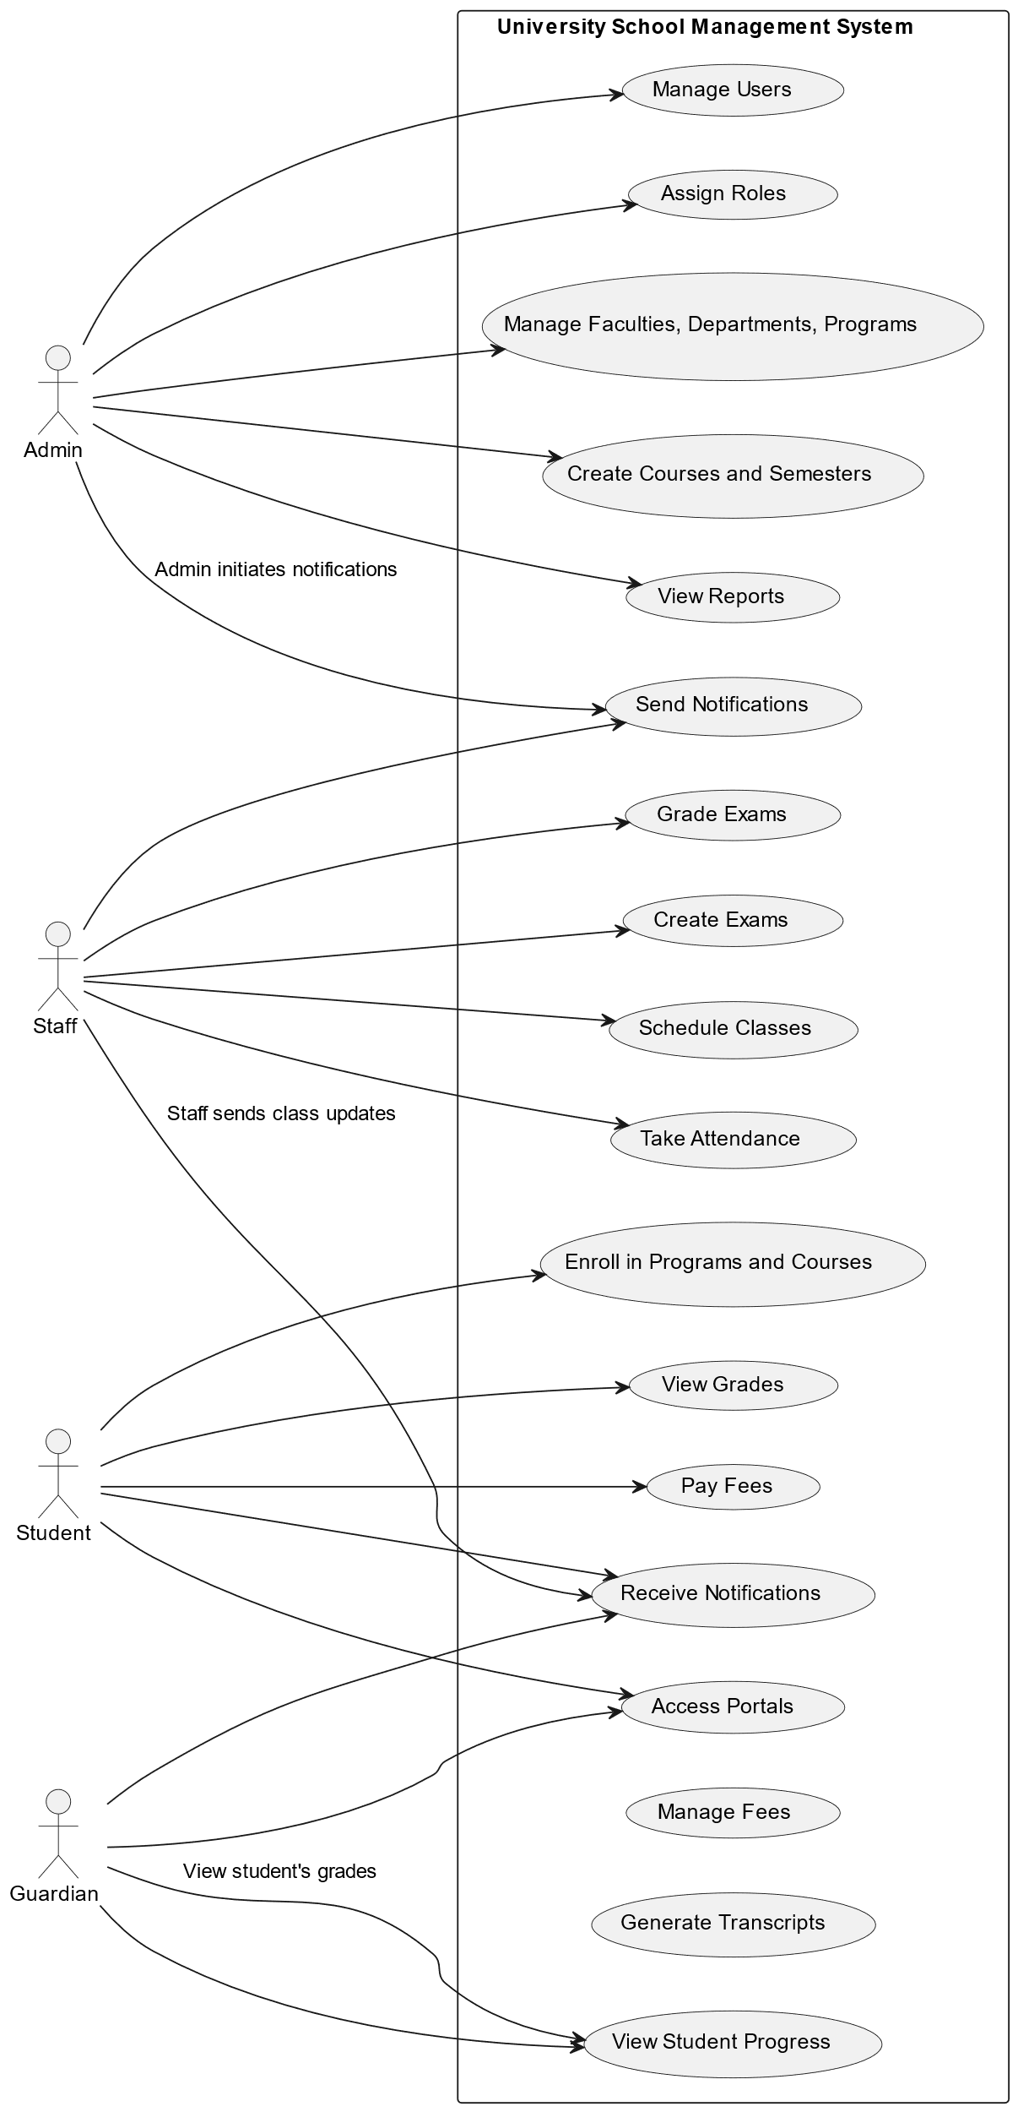
Use Case Diagram

Slide 17

Project UI/UX
07

Slide 18
ACADEMIA COLOR PALETS, BRANDING AND TYPOGRAPHY
#597ABD
Steel Blue
Aa
Calmness, trust, and professionalism
#FFFFFF
White
Merriweather Sans
Purity, simplicity , cleanliness and peace
#1E1E1E
Charcoal Black
Sophistication, elegance, and formality
#FFC107
Golden Yellow
ACADEMIA LOGO
Sophistication, elegance, and formality

Slide 19
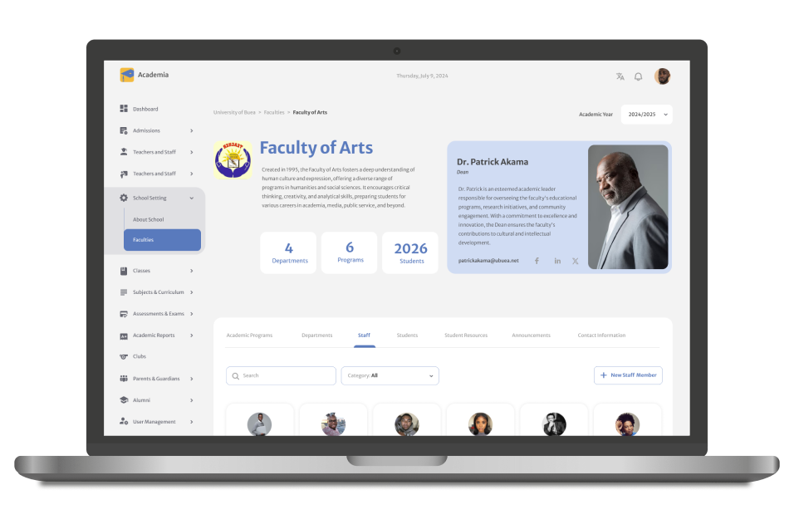

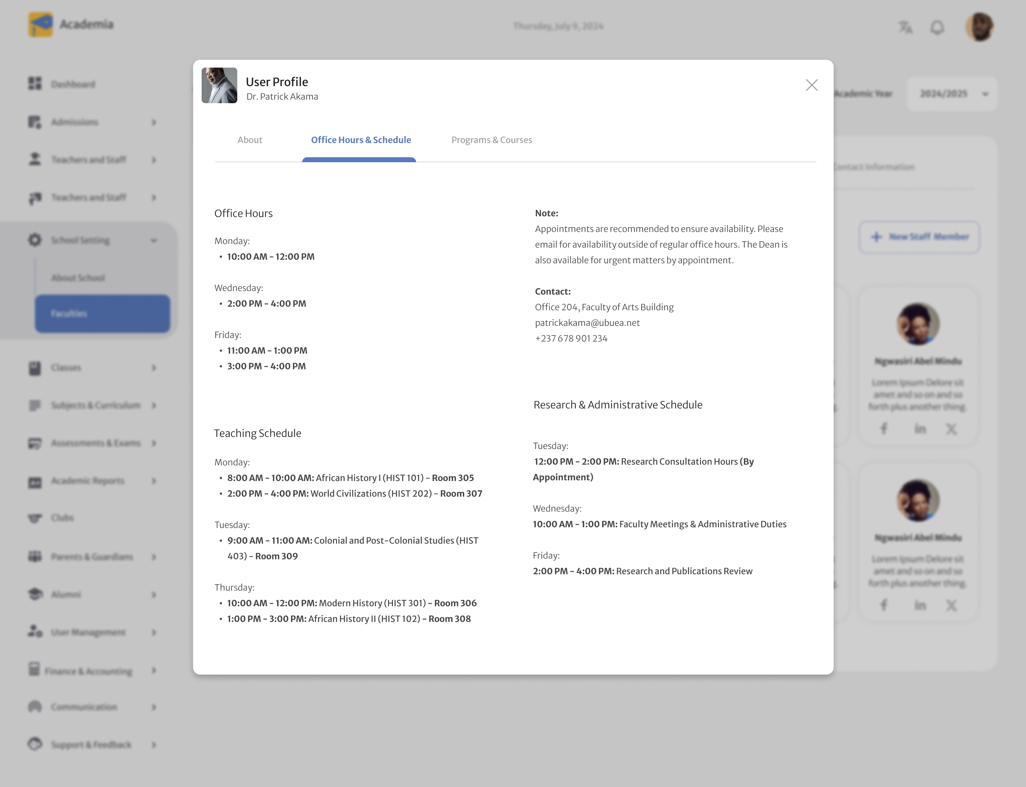
Faculty Detail Page and User Profile

Slide 20

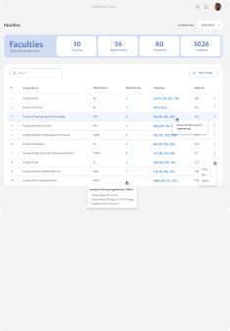
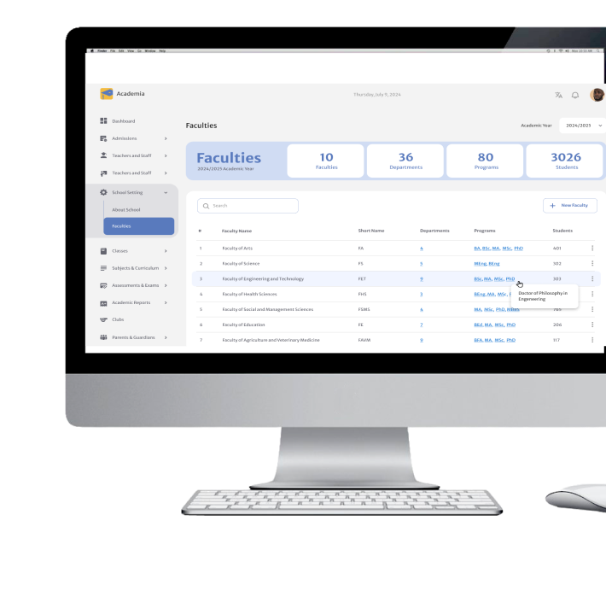
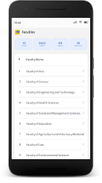
Faculty Listing Page in all Views

Slide 21

Tasks Assigned
08

Slide 22

Entry Tasks

Slide 24

Challenges & Solutions
09

Slide 25
Problem vs. Solution
Time Management
Debugging Issues
Observed others and adapted to their pace on tasks assigned
Consulted supervisors, interns ,company engineers and other online sources
01
50 %
50 %
02
04
Learning New Technology
Adaptability
Studied online documentations and other soures
03
I observed others, adapted and gradually met expectations
75 %
60 %

Slide 26

Conclusion
08

Slide 28



